Slide 1
Problem Identification
FastEight has the most missing values, at just over 50%
Over 82% of resorts have no missing ticket price, 3% are missing one value, and 14% are missing both
We have a duplicated Crystal Mountain resort name, but they are clearly two different resorts in two different states
Some resorts have been open for 2019 years. This is wrong. It likely means the resort opened in 2019 or due to open in 2019
There some states are higher in some but not in others. Some features are more correlated with one another than others. Like New York State boasts an especially large night skiing area, and it had the most resorts but wasn't in the top five largest states.
Ticket prices are diiferent from states to states, and weekend vs weekday

Slide 2
Modeling
So to predict the ticket prices, we use mean as an average to run some tests here:
Because we left many missing values in the data, we now can impute missing values using scikit-learn.
We have:
median_mae = mean_absolute_error(y_train, y_tr_pred), mean_absolute_error(y_test, y_te_pred)median_mae
= (8.554121503704273, 10.077943191488188)
Using this model, then, on average you'd expect to estimate a ticket price within $9.

Slide 3
Linear Regression Model
vertical_drop 10.767857
Snow Making_ac 6.290074
total_chairs 5.794156
fastQuads 5.745626
Runs 5.370555
LongestRun_mi 0.181814
trams -4.142024
SkiableTerrain_ac -5.249780
These results suggest that vertical drop is your biggest positive feature. This makes intuitive sense and is consistent with what you saw during the EDA work. Also, you see the area covered by snow making equipment is a strong positive as well. People like guaranteed skiing! The skiable terrain area is negatively associated with ticket price!

Slide 4
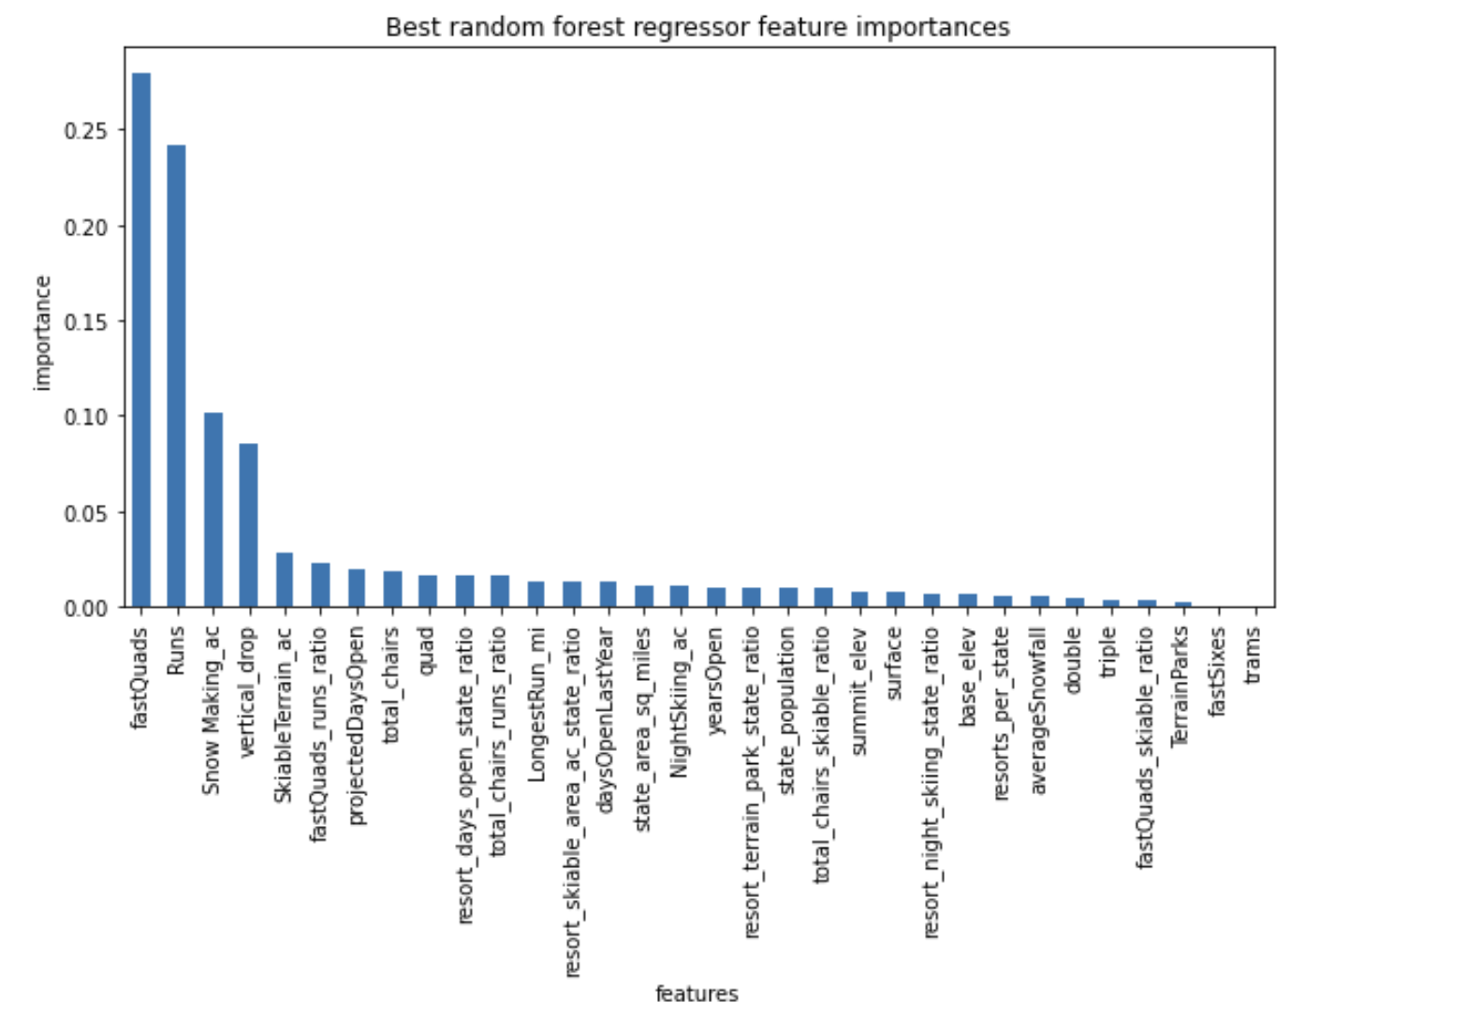
Random Forest Model
This model gives us the the dominant top four features are in common with your linear model:
fastQuads
Runs
Snow Making_ac
vertical_drop

Slide 5
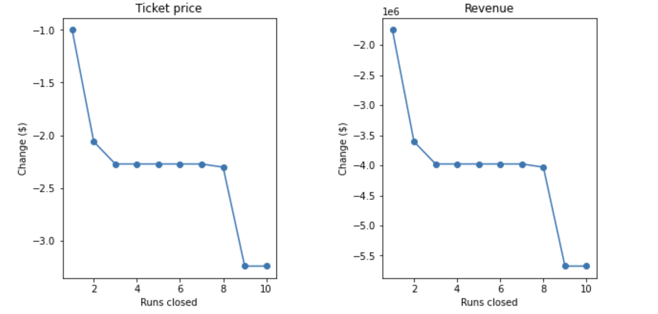
Summary and conclusion
Big Mountain Resort modelled price is $95.97, actual price is $81.00. Even with the expected mean absolute error of $10.50, this suggests there is room for an increase.
Business has shortlisted some options:
1. Permanently closing down up to 10 of the least used runs. This doesn't impact any other resort statistics.
The model says closing one run makes no difference. Closing 2 and 3 successively reduces support for ticket price and so revenue. If Big Mountain closes down 3 runs, it seems they may as well close down 4 or 5 as there's no further loss in ticket price. Increasing the closures down to 6 or more leads to a large drop.

Slide 6
2. Increase the vertical drop by adding a run to a point 150 feet lower down but requiring the installation of an additional chair lift to bring skiers back up, without additional snow making coverage
This scenario increases support for ticket price by $9.45
Over the season, this could be expected to amount to $16,545,455
3. Same as number 2, but adding 2 acres of snow making cover
This scenario increases support for ticket price by $9.88
Over the season, this could be expected to amount to $17,287,879
4. Increase the longest run by 0.2 mile to boast 3.5 miles length, requiring an additional snow making coverage of 4 acres
There is no difference
In conclusion, I would choose scenario 2 as my final option

